Slide 1
SEAN KIM
L/E option
AE Thesis Presentation

Slide 2
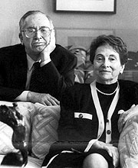
Introduction
Lighting Depth │ Main Lobby
Electrical Depth
Mechanical Breadth
Conclusion
Building Overview
Performance Hall
Performance Penthouse
“The Logan family sees the center not as a building project… but as a way to improve the quality of life for students and faculty of the University, as well as the community.”
- David Logan
David Logan, and Reva Logan
[From: http://arts.uchicago.edu/logan-center/about-logan-center]
Notes:
On May 3, 2007, the University of Chicago made a historic announcement: David Logan, AB'39, JD'41, and his wife Reva and their sons and grandchildren had generously committed a $35 million gift to support the University’s Center for the Creative and Performing Arts. Not only was this one of the largest single donor gifts to the University, it is also believed to be both the single largest cash gift to the arts in the city of Chicago and one of the largest gifts to support a university arts building in the United States. Five years after the Logan family gave their record gift of $35 million, the Logan Center for the Arts celebrated its grand opening.

Slide 3
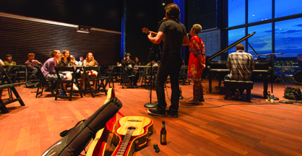
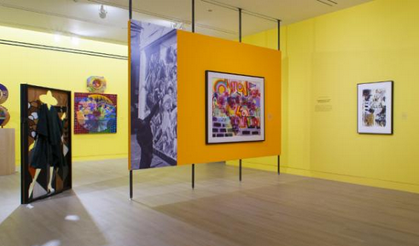
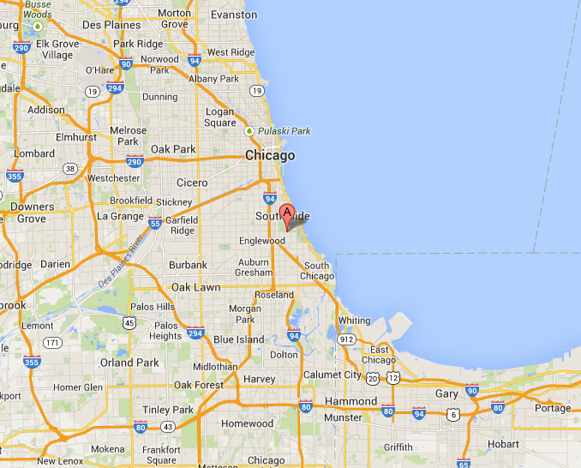
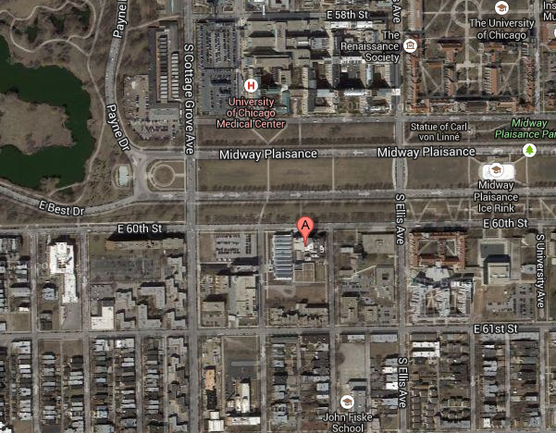
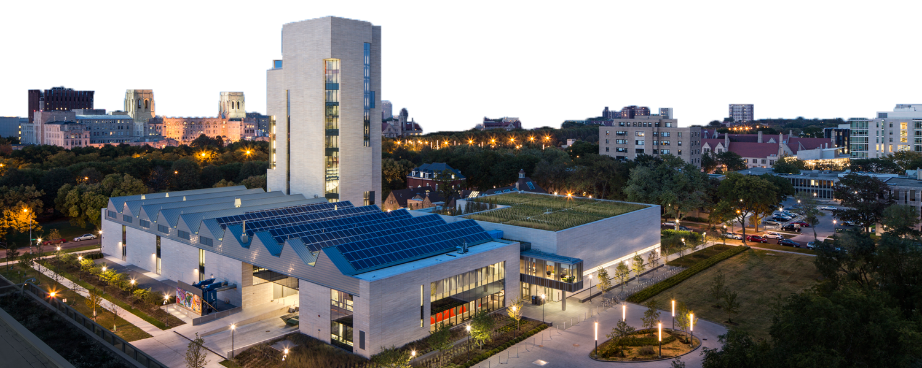
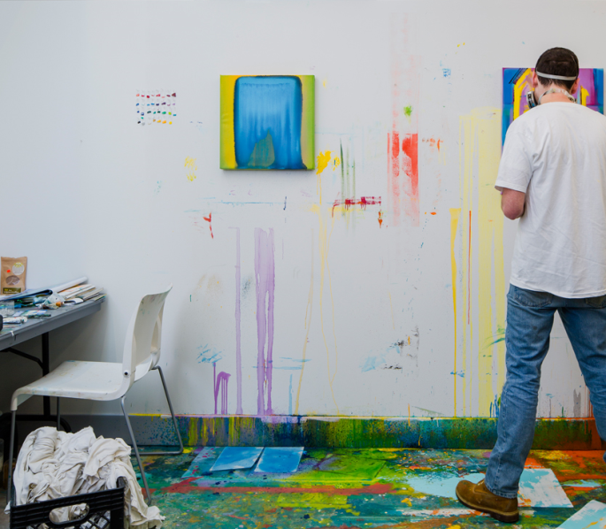
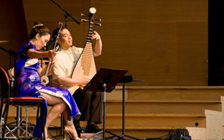
Introduction
Lighting Depth │ Main Lobby
Electrical Depth
Mechanical Breadth
Conclusion
Building Overview
Performance Hall
Performance Penthouse
Reva and David Logan Center for the Arts
Building Type: Multidisciplinary arts center
Owner: University of Chicago
Size: 184,000 square foot
Design Architect: Tod Williams Billie Tsien Architects
Stories:
11-story tower with
3-story adjacent building
Lighting Design: Refro Design Group
MEP Engineer:
Ambrosino Depinto &Schmieder Consulting Engineering
Construction Manager: Turner Construction, LLC
[From: google map]
[From: http://arts.uchicago.edu/logan-center/about-logan-center]
[From: http://arts.uchicago.edu/logan-center/about-logan-center]

Slide 4
Introduction
Lighting Depth │ Main Lobby
Electrical Depth
Mechanical Breadth
Conclusion
Building Overview
Performance Hall
Performance Penthouse
Lighting Depth │ Main Lobby
Lighting Depth │ Performance Hall
Lighting Depth │ Performance Penthouse
Lighting Depth │ Courtyard
Electrical Depth │ Size reduction of Emergency Generator
Lighting Depth │ MCB for Main Distribution Switchboard
Lighting Depth │ High-Efficiency dry-type Transformer
Acoustical Breadth │ Reverberation Time & Bass Ratio
Acoustical Breadth for Performance Hall
Mechanical Breadth │ Solar Heat Gain & Cooling Load of Different Mechanical Mechanical Breadth │ Glazing type on the Corridor

Slide 5
Introduction
Lighting Depth │ Main Lobby
Electrical Depth
Mechanical Breadth
Conclusion
Building Overview
Performance Hall
Performance Penthouse
Lighting Depth │ Main Lobby
Lighting Depth │ Performance Hall
Lighting Depth │ Performance Penthouse
Lighting Depth │ Courtyard
Electrical Depth │ Size reduction of Emergency Generator
Lighting Depth │ MCB for Main Distribution Switchboard
Lighting Depth │ High-Efficiency dry-type Transformer
Acoustical Breadth │ Reverberation Time & Bass Ratio
Acoustical Breadth for Performance Hall
Mechanical Breadth │ Solar Heat Gain & Cooling Load of Different Mechanical Mechanical Breadth │ Glazing type on the Corridor

Slide 6
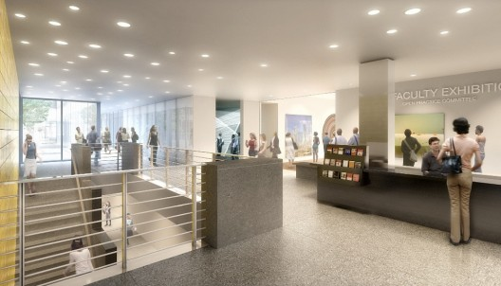
Introduction
Lighting Depth │ Main Lobby
Electrical Depth
Mechanical Breadth
Conclusion
Building Overview
Performance Hall
Performance Penthouse
Entry Lobby
Design Goal
Powerful atmosphere
Create welcoming environment
Way finding
Public impressions
Corridor
[From: http://facilities.uchicago.edu/construction/performing-arts/]

Slide 7
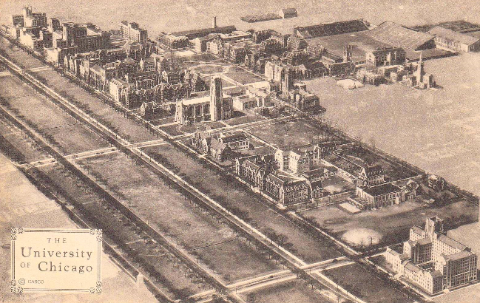
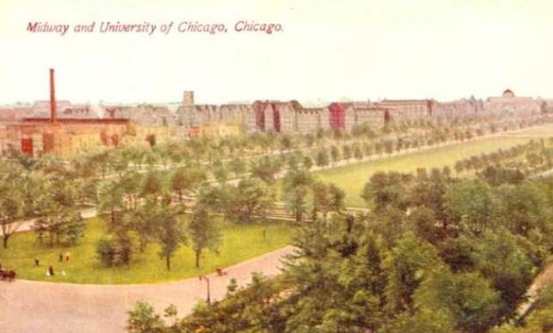
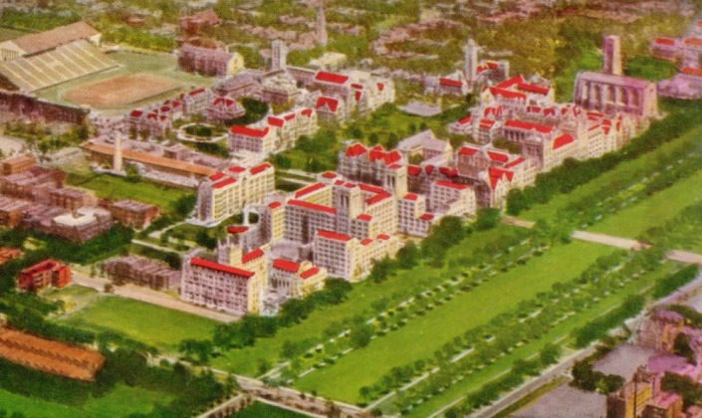
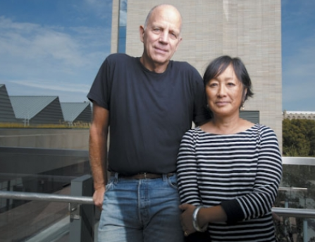
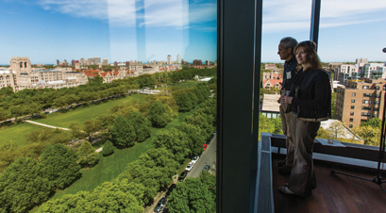
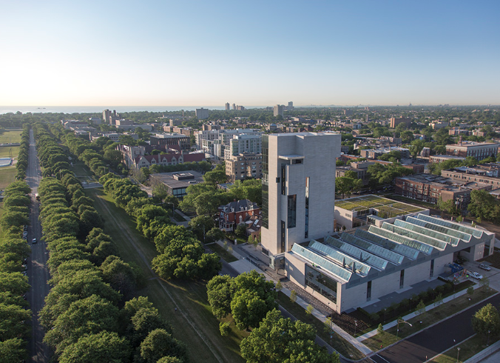
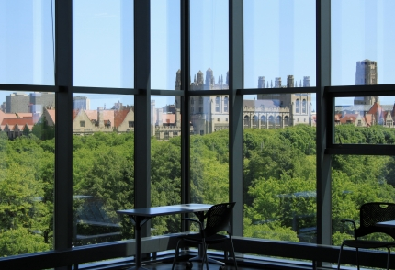
Introduction
Lighting Depth │ Main Lobby
Electrical Depth
Mechanical Breadth
Conclusion
Building Overview
Performance Hall
Performance Penthouse
“The idea of the low, sky lit building of studios and theaters, and the tower of the arts came from imagining the flat prairies of the Midwest and the great towers of Chicago.”
- Tod Williams & Billie Tsien, Architects
http://arts.uchicago.edu/logan-center/about/about-logan-center-0
[From: google map, University of Chicago, ]

Slide 8
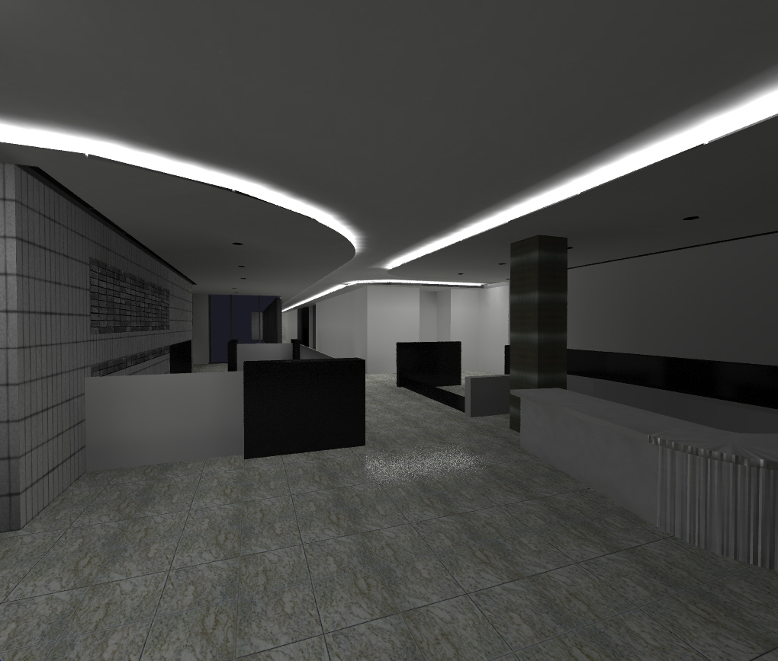
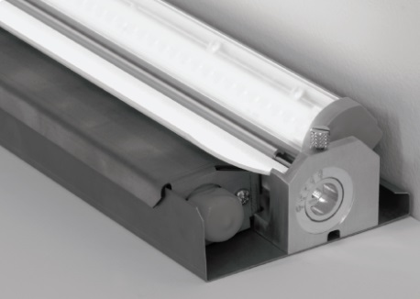
Introduction
Lighting Depth │ Main Lobby
Electrical Depth
Mechanical Breadth
Conclusion
Building Overview
Performance Hall
Performance Penthouse
LED Cove Lighting

Slide 9
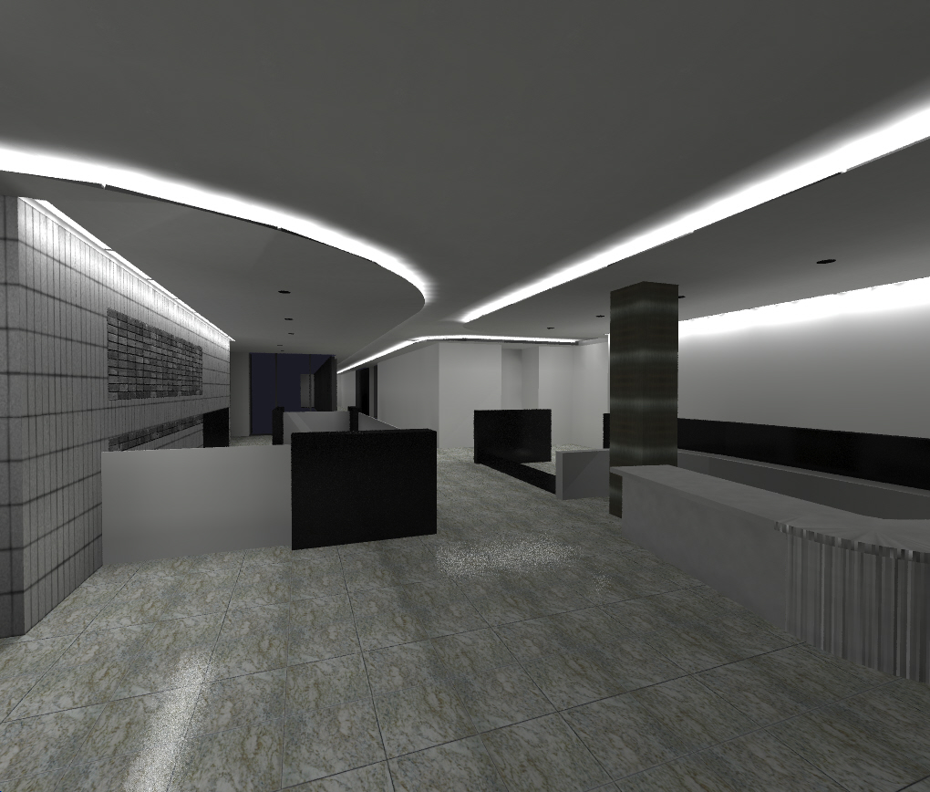
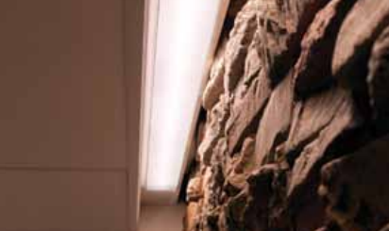
Introduction
Lighting Depth │ Main Lobby
Electrical Depth
Mechanical Breadth
Conclusion
Building Overview
Performance Hall
Performance Penthouse
LED Cove Lighting
LED Wall glazing

Slide 10
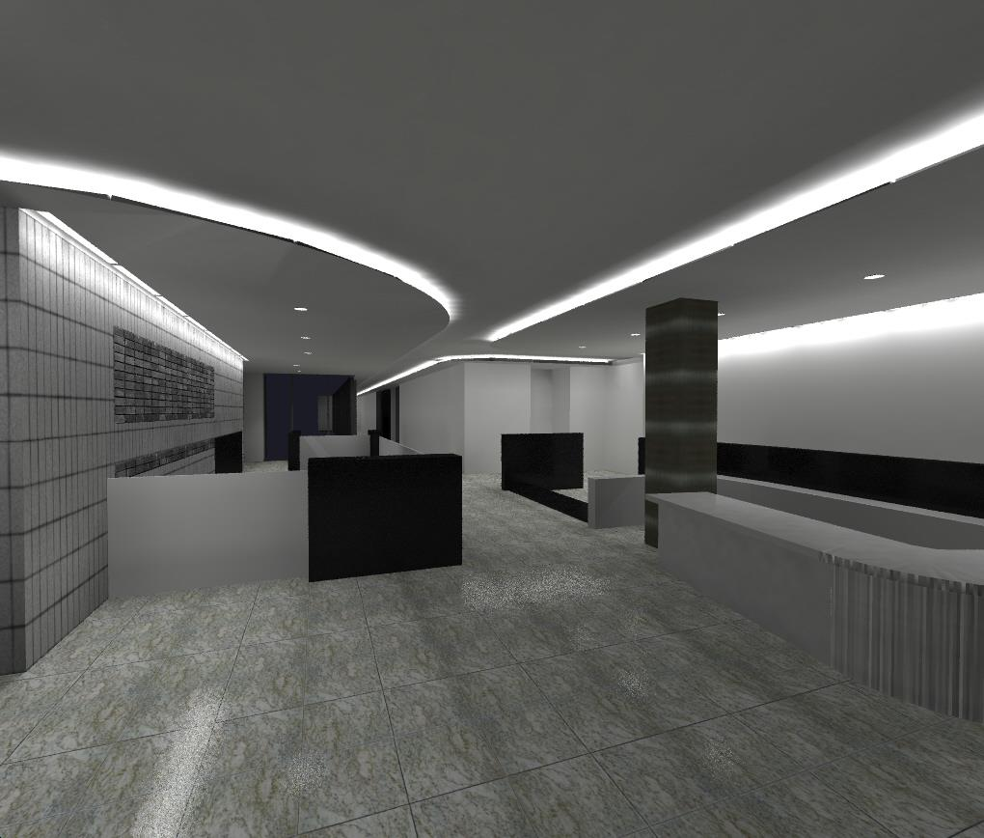
Introduction
Lighting Depth │ Main Lobby
Electrical Depth
Mechanical Breadth
Conclusion
Building Overview
Performance Hall
Performance Penthouse
LED Cove Lighting
LED Wall glazing
Compact Fluorescent Downlight

Slide 11
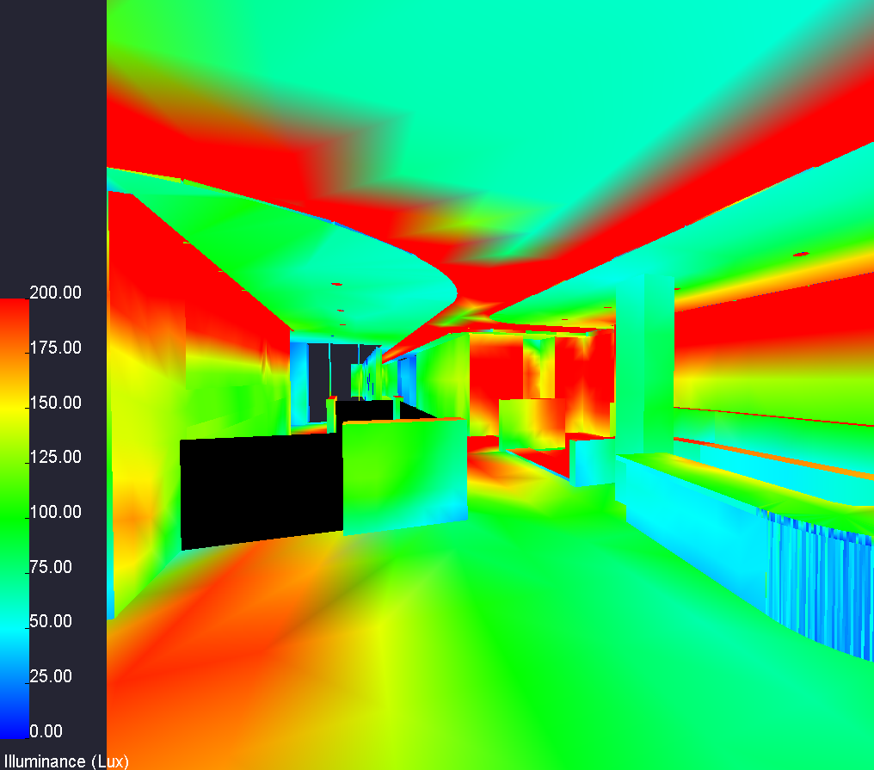
Introduction
Lighting Depth │ Main Lobby
Electrical Depth
Mechanical Breadth
Conclusion
Building Overview
Performance Hall
Performance Penthouse

Slide 12
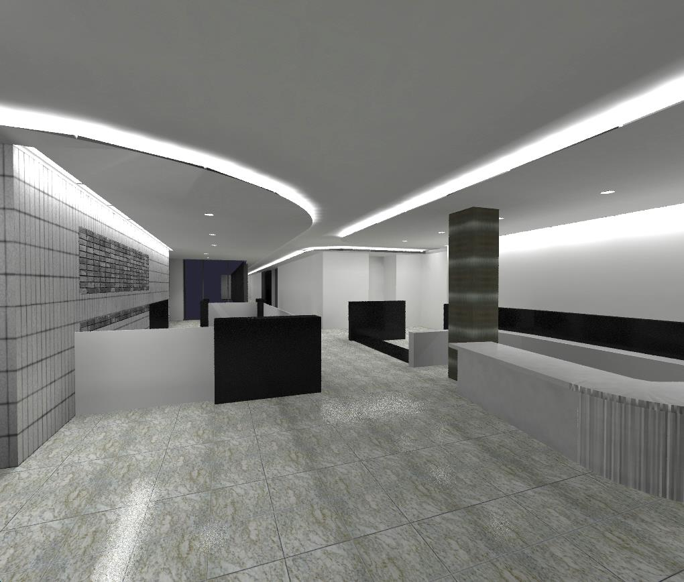
Introduction
Lighting Depth │ Main Lobby
Electrical Depth
Mechanical Breadth
Conclusion
Building Overview
Performance Hall
Performance Penthouse
Eh (lux) Avg:Min
IES Criteria: Lobby
50
4:1
Design Proposed: Lobby
95.19
1.92:1
IES Criteria: Reception Desk
150
4:1
Design Proposed: Reception Desk
164.6
2.2:1
Power Density (W/ft²)
ASHRAE 90.1 (2010): Lobby
1.3
Design Proposed: Lobby
0.64

Slide 13
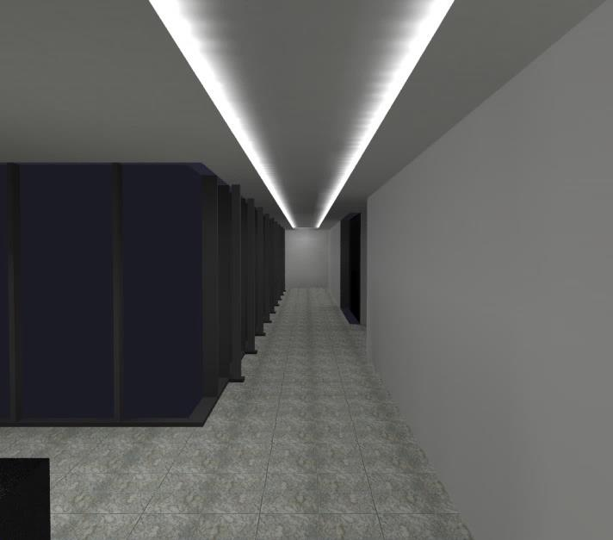
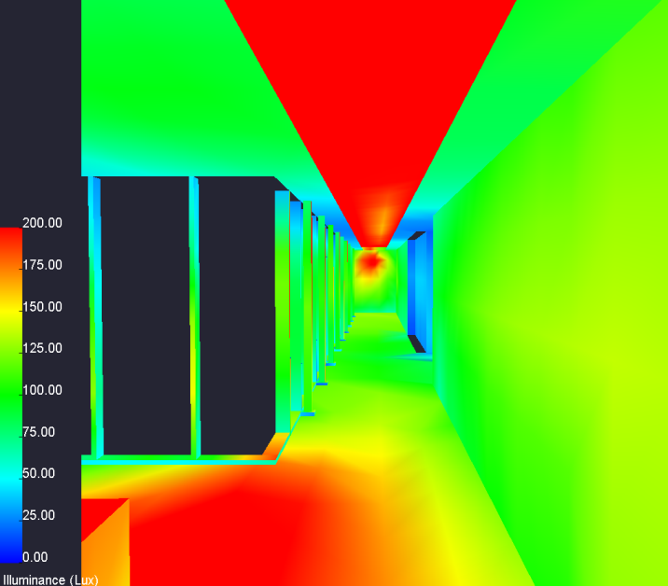
Introduction
Lighting Depth │ Main Lobby
Electrical Depth
Mechanical Breadth
Conclusion
Building Overview
Performance Hall
Performance Penthouse

Slide 14
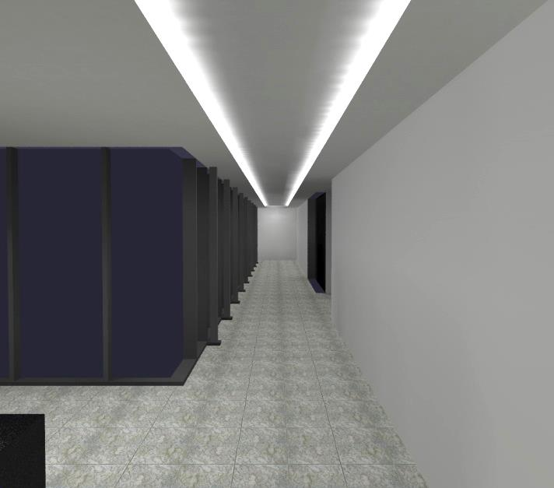
Introduction
Lighting Depth │ Main Lobby
Electrical Depth
Mechanical Breadth
Conclusion
Building Overview
Performance Hall
Performance Penthouse
Eh (lux) Avg:Min
IES Criteria: Corridor
50
4:1
Design Proposed: Corridor
95.8
1.85:1
Power Density (W/ft²)
ASHRAE 90.1 (2010): Lobby
0.5
Design Proposed: Lobby
0.87

Slide 15
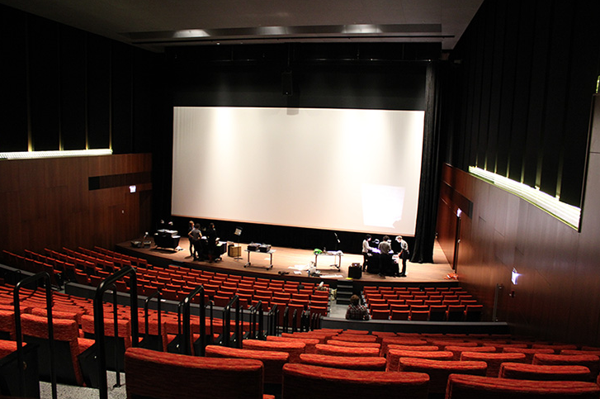
Introduction
Lighting Depth │ Main Lobby
Electrical Depth
Mechanical Breadth
Conclusion
Building Overview
Performance Hall
Performance Penthouse
Design Goal
Uniform Light Distribution with Comfort
Pleasant Environment with Relax Atmosphere
Avoid Visual Distraction
Three Design Concepts
[From: http://facilities.uchicago.edu/construction/performing-arts/]

Slide 16
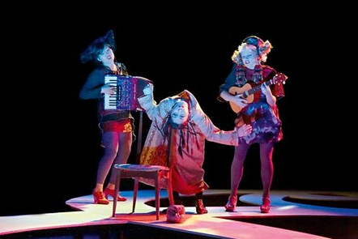
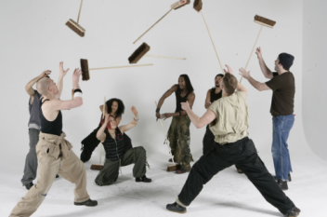
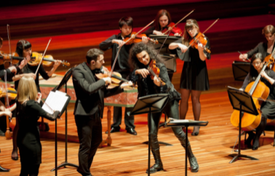
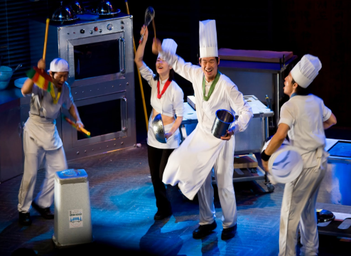
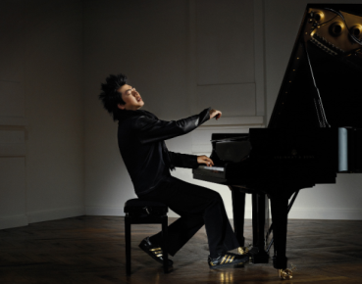
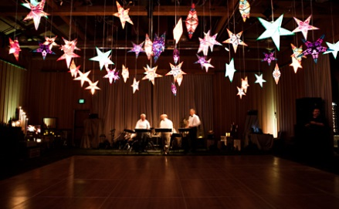
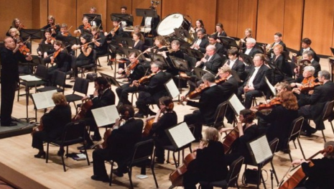
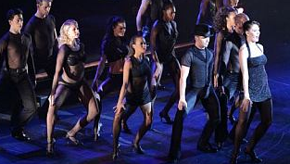
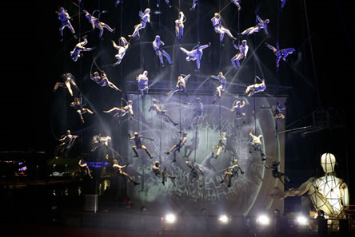
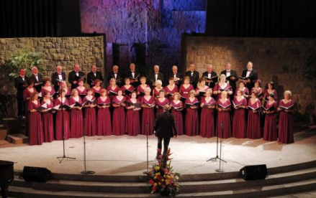
Introduction
Lighting Depth │ Main Lobby
Electrical Depth
Mechanical Breadth
Conclusion
Building Overview
Performance Hall
Performance Penthouse
Modernism
Sophisticated
Classical
Dynamic with Linear
Intense glare but simple
Greek Doric Columns

Slide 17
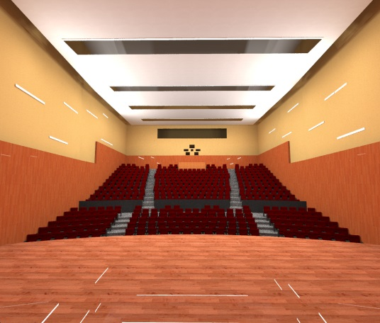
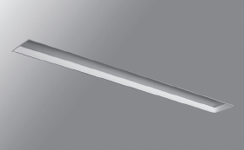
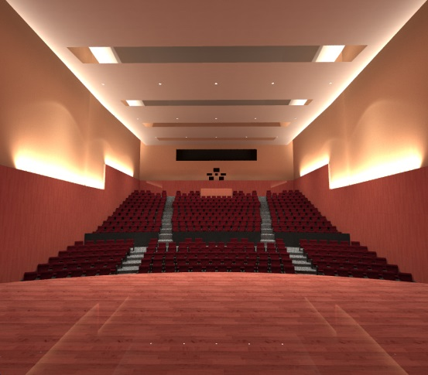
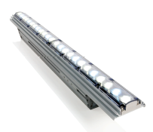
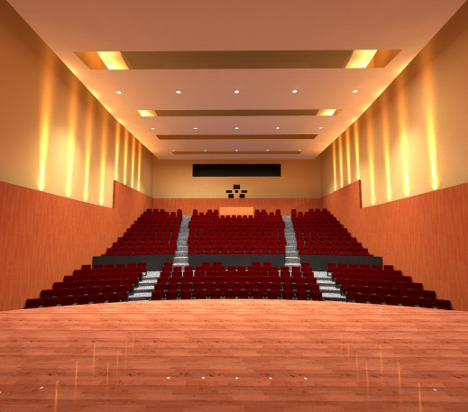
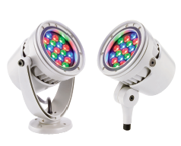
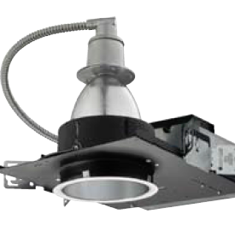
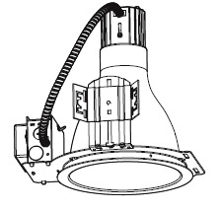
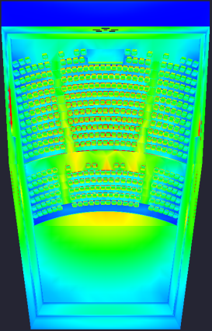
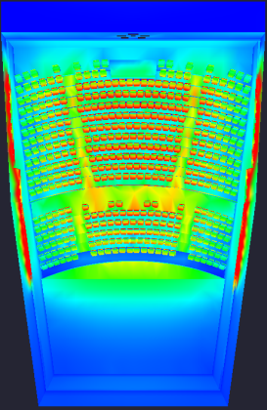
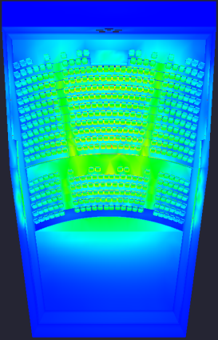
Introduction
Lighting Depth │ Main Lobby
Electrical Depth
Mechanical Breadth
Conclusion
Building Overview
Performance Hall
Performance Penthouse
Modernism
Sophisticated
Classical

Slide 18
Introduction
Lighting Depth │ Main Lobby
Electrical Depth
Mechanical Breadth
Conclusion
Building Overview
Performance Hall
Performance Penthouse
Eh (lux) Avg:Min
IES Design Criteria
100
2:1
Modernism
112.3
1.8:1
Sophisticated
117.8
2.2:1
Classical
95.3
2.1:1
Power Density (W/ft²)
ASHRAE 90.1 (2010)
2.6
Modernism
0.72
Sophisticated
0.76
Classical
0.57

Slide 19
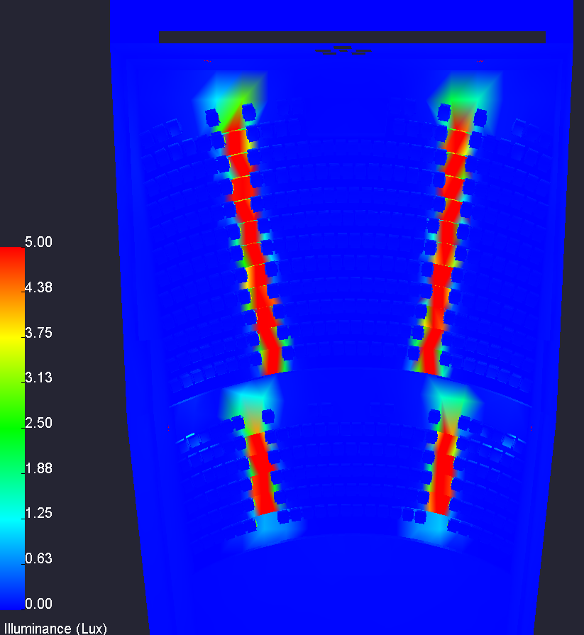
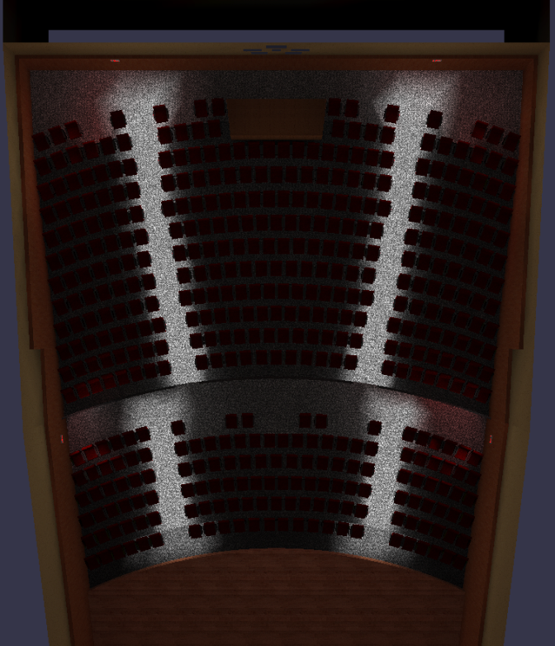
Introduction
Lighting Depth │ Main Lobby
Electrical Depth
Mechanical Breadth
Conclusion
Building Overview
Performance Hall
Performance Penthouse
Egress Lighting
Eh
N.F.P.A. Code Minimum
0.2 fc
Design Proposed
0.38 fc
LED Seat Light
Wall Surface “Exit” panel

Slide 20
Introduction
Lighting Depth │ Main Lobby
Electrical Depth
Mechanical Breadth
Conclusion
Building Overview
Performance Hall
Performance Penthouse
Design Goal
Uniform Light Distribution
Flexible lighting
Provide different Scenes for various activities
[From: http://facilities.uchicago.edu/construction/performing-arts/]

Slide 21
Introduction
Lighting Depth │ Main Lobby
Electrical Depth
Mechanical Breadth
Conclusion
Building Overview
Performance Hall
Performance Penthouse
Zone 1
Zone 2
Zone 3
Zone 4
Zone 5
Custom LED Pendant Light
(2) for down, (1) for Up
3” aperture Recessed Downlight
LED Spot Light

Slide 22
Introduction
Lighting Depth │ Main Lobby
Electrical Depth
Mechanical Breadth
Conclusion
Building Overview
Performance Hall
Performance Penthouse
Zone 1 – 100% Output
Zone 2 – 100% Output
Zone 3 – 100% Output
Zone 4 – ON
Zone 5 – ON
Eh (lux) Avg:Min
IES Criteria: Dance (Performance)
300
1.5:1
Design Proposed: All Lights On
338.26
1.6:1
Power Density (W/ft²)
ASHRAE 90.1 (2010)
1.4
Design Proposed: Lobby
1.1

Slide 23
Introduction
Lighting Depth │ Main Lobby
Electrical Depth
Mechanical Breadth
Conclusion
Building Overview
Performance Hall
Performance Penthouse
Zone 1 – 100% Output
Zone 2 – 100% Output
Zone 3 – 100% Output
Zone 4 – ON
Zone 5 – ON

Slide 24
Introduction
Lighting Depth │ Main Lobby
Electrical Depth
Mechanical Breadth
Conclusion
Building Overview
Performance Hall
Performance Penthouse
Zone 1 – 50% Output
Zone 2 – 50% Output
Zone 3 – 50% Output
Zone 4 – ON
Zone 5 – ON

Slide 25
Introduction
Lighting Depth │ Main Lobby
Electrical Depth
Mechanical Breadth
Conclusion
Building Overview
Performance Hall
Performance Penthouse
Zone 1 – OFF
Zone 2 – OFF
Zone 3 – OFF
Zone 4 – ON
Zone 5 – ON

Slide 26
Introduction
Lighting Depth │ Main Lobby
Electrical Depth
Mechanical Breadth
Conclusion
Building Overview
Performance Hall
Performance Penthouse
December 22, 10:00 am
Zone 1 – OFF
Zone 2 – OFF
Zone 3 – OFF
Zone 4 – OFF
Zone 5 – OFF

Slide 27
Introduction
Lighting Depth │ Main Lobby
Electrical Depth
Mechanical Breadth
Conclusion
Building Overview
Performance Hall
Performance Penthouse
December 22, 10:00 am with Shade
December 22, 10:18 am with Shade
Zone 1 – OFF
Zone 2 – OFF
Zone 3 – OFF
Zone 4 – OFF
Zone 5 – OFF

Slide 28
Introduction
Lighting Depth │ Main Lobby
Electrical Depth
Mechanical Breadth
Conclusion
Building Overview
Performance Hall
Performance Penthouse
Zone 1 – 50% Output
Zone 2 – 25% Output
Zone 3 – Only Uplight
Zone 4 – OFF
Zone 5 – ON

Slide 29
Introduction
Lighting Depth │ Main Lobby
Electrical Depth
Mechanical Breadth
Conclusion
Building Overview
Performance Hall
Performance Penthouse
Study of High Efficiency transformer
with Energy cost saving

Slide 30
Introduction
Lighting Depth │ Main Lobby
Electrical Depth
Mechanical Breadth
Conclusion
Building Overview
Performance Hall
Performance Penthouse
Schedule of Existing Transformers in Logan Center for the Arts
No. | Rating of Unit | Primary V | Secondary V | Location | Feeding to | Note
T-1 | 150 kVA | 277/480 | 120/208 | Lower Level | to LV-EM-LL | Switchboard
T-2 | 57 kVA | 277/480 | 120/208 | Lower Level | to EM-PP-LL | Panelboard
T-3 | 45 kVA | 277/480 | 120/208 | First Floor | to PP-TH-1 | Panelboard
T-4* | 30 kVA | 277/480 | 120/208 | Lower Level | to LP-AV-LL | Panelboard
T-5* | 30 kVA | 277/480 | 120/208 | First Floor | to LP-AV-1 | Panelboard
T-6 | 76 kVA | 277/480 | 120/208 | Eleventh Floor | to TLP-7-11 | Panelboard
T-7 | 300 kVA | 277/480 | 120/208 | Lower Level | to LV-DP-LL-N | Switchboard
T-8 | 112.5 kVA | 277/480 | 120/208 | Second Floor | to TLP-3-6 | Panelboard
T-9 | 75 kVA | 277/480 | 120/208 | Second Floor | to PNL-#1 | THEATRICAL BRK at 245
T-10 | 45 kVA | 277/480 | 120/208 | Second Floor | to PP-TH-2B | Panelboard
T-11 | 225 kVA | 277/480 | 120/208 | Lower Level | to SP-201, Dimmer Racks 201,202 | at 245
T-12 | 150 kVA | 277/480 | 120/208 | First Floor | to SP-101, Dimmer Racks 101,102 | at 245
T-13 | 75 kVA | 277/480 | 120/208 | Second Floor | to PNL-#2 | THEATRICAL BRK at 245
T-14 | 45 kVA | 277/480 | 120/208 | Second Floor | to PP-TH-2A | Panelboard
T-15 | not shown in Single-Line Diagram
T-16 | 45 kVA | 277/480 | 120/208 | Third Floor | to PP-SR | Panelboard
T-17 | 75 kVA | 277/480 | 120/208 | Second Floor | to PNL-#1 | THEATRICAL BRK at 210B
T-18 | 75 kVA | 277/480 | 120/208 | Second Floor | to PNL-#2 | THEATRICAL BRK at 210B
T-19 | 225 kVA | 277/480 | 120/208 | Second Floor | to Dimmer Racks 1,2,3 | at 210B
T-20 | 500 kVA | 277/480 | 120/208 | Lower Level | to LV-SB-SS-S | Switchboard
T-21 | 45 kVA | 277/480 | 120/208 | Lower Level | to Courtyard Projection
T-22 | 30 kVA | 277/480 | 120/208 | Eleventh Floor | to Dimmer Racks 301 | at 301
T-23 | 45 kVA | 277/480 | 120/208 | Lower Level | to LP-LL-NA | Panelboard
Existing Transformers
Proposed Solution
Rating of Unit | # of Unit
30 kVA | 3
45 kVA | 6
57 kVA | 1
75 kVA | 4
76 kVA | 1
112.5 kVA | 1
150 kVA | 2
225 kVA | 2
300 kVA | 1
500 kVA | 1
Total | 22
Total 22 K-rated transformers
NEMA TP-1 for energy efficiency
T-4 and T-5 are designed as Isolation transformer
T-20 with 500KVA is designed K-factor of 13
EATON: Premium efficient transformer
30% less losses than NEMA TP- 1 for energy consumption
Reduced operating costs
Available as K-factor or harmonic mitigating

Slide 31
Introduction
Lighting Depth │ Main Lobby
Electrical Depth
Mechanical Breadth
Conclusion
Building Overview
Performance Hall
Performance Penthouse
Total Loss Per Year
Proposed Solution
Summary
EATON: Premium efficient transformer
30% less losses than NEMA TP- 1 for energy consumption
Reduced operating costs
Available as K-factor or harmonic mitigating
Energy Cost Savings: $4,119 per year
Reduction in Power Lost by Transformer: 38.96 MW per year
HVAC Savings: 19.48 MBT per year
Energy Life Cycle Costs

Slide 32
Introduction
Lighting Depth │ Main Lobby
Electrical Depth
Mechanical Breadth
Conclusion
Building Overview
Performance Hall
Performance Penthouse
Study of Solar Heat Gain & Cooling Loads
with Different glazing type

Slide 33
Introduction
Lighting Depth │ Main Lobby
Electrical Depth
Mechanical Breadth
Conclusion
Building Overview
Performance Hall
Performance Penthouse
First Floor Plan View
Elevation View
Existing Glazing type
N
Double Glazing type
Thickness: 1 3/16”
SHGC: 0.41
U-Value (winter): 0.3 Btu/hr*Sqft*F
Dimension: 90.88’ L x 10’ H
Area: 908.8 sq.ft
East-facing window
http://www.ppg.com/corporate/ideascapes/glass/Pages/default.aspx

Slide 34
Introduction
Lighting Depth │ Main Lobby
Electrical Depth
Mechanical Breadth
Conclusion
Building Overview
Performance Hall
Performance Penthouse
Proposed 1
Proposed 2
Existing Glazing type
Triple Glazing type
Thickness: 1 13/16”
SHGC: 0.23
U-Value (winter): 0.12 Btu/hr*Sqft*F
Single Glazing type
Thickness: 1/2”
SHGC: 0.36
U-Value (winter): 0.95 Btu/hr*Sqft*F
Double Glazing type
Thickness: 1 3/16”
SHGC: 0.41
U-Value (winter): 0.3 Btu/hr*Sqft*F
http://www.ppg.com/corporate/ideascapes/glass/Pages/default.aspx
http://www.ppg.com/corporate/ideascapes/glass/Pages/default.aspx
http://www.ppg.com/corporate/ideascapes/glass/Pages/default.aspx

Slide 35
Introduction
Lighting Depth │ Main Lobby
Electrical Depth
Mechanical Breadth
Conclusion
Building Overview
Performance Hall
Performance Penthouse
Solar Heat Gain for Summer
Cooling Load for Summer
Total Cooling Load
Btu/Hr
Btu/Hr
After Noon
Btu
133673.4 Btu More
153555.1 Btu less

Slide 36
Introduction
Lighting Depth │ Main Lobby
Electrical Depth
Mechanical Breadth
Conclusion
Building Overview
Performance Hall
Performance Penthouse
Summary
Total Cooling Load
(June, 21 in the Corridor) (* 0.112 $/Kwh)
Btu
$
14.84
133673.4 Btu More
10.56
153555.1 Btu less
5.53

Slide 37
Introduction
Lighting Depth │ Main Lobby
Electrical Depth
Mechanical Breadth
Conclusion
Building Overview
Performance Hall
Performance Penthouse
Conclusion
Thank you!
References
Lighting: Provided various lighting designs reflecting the purpose of the space
Electrical: Saved $4,119 per year in energy cost with High-efficiency transformer
Mechanical: Triple pane in the corridor provides 47% of cooling load cost saving during the summer.
Acknowledgements
Dr. Houser
Dr. Mistrick
Professor Parfitt
W. Blair Malcom
Eric Eichler
- DiLaura DL, Houser KW, Mistrick RG, Steff GR. Illuminating Engineering Society The Lighting HandBook
10th Edition.
- ASHRAE Standard 90.1, 2007 – Energy Standard for Building Except Low-Rise Residential Buildings.
- National fire Protection Association 101, 2009: Life Safety Code – 7.8 Illumination of Means of Egress.
- Facilities Services Facility Standards (FS) 2 of the Univeristy of Chicago, Volume III, M-Electrical Systems.
- Kotey, Nathan A.; Wright, John L.; Collins, Michael R.; Barnaby, Charles S. "Solar gain through windows with shading devices: simulation versus measurement" The Free Library 01 July 2009. 09 April 2014 , Retrieved from http://www.thefreelibrary.com/Solar gain through windows with shading devices: simulation versus...-a0217848187.
- “Energy Savings Calculator for Eaton Transformers”, 2013, Eaton Corporation, Retrieved from <http://es.eaton.com/transformercalc/index.php#calc>
- “Glass Configuration tools”, 2014, PPG Industries, Retrieved from http://construct.ppg.com.

Slide 38
Introduction
Lighting Depth │ Main Lobby
Electrical Depth
Mechanical Breadth
Conclusion
Building Overview
Performance Hall
Performance Penthouse
Solar Heat Gain for Summer
Cooling Load for Summer
Total Cooling Load & Heat Gain
June, 21 | Total Cooling Load & Heat Gain
Existing Glazing - Double | 322055.9 BTU
Proposed Type 1 - Triple | 168500.8 BTU
Proposed Type 2 - Single | 455729.3 BTU

Slide 39
Introduction
Lighting Depth │ Main Lobby
Electrical Depth
Mechanical Breadth
Conclusion
Building Overview
Performance Hall
Performance Penthouse
Solar Heat Gain for Winter
Cooling Load for winter
Total Cooling Load & Heat Gain
December, 21 | Total Cooling Load & Heat Gain
Existing Glazing - Double | 158137 BTU
Proposed Type 1 - Triple | 102726.3 BTU
Proposed Type 2 - Single | 311800.5 BTU

